Slide 1



Sync 2.2 Controlled vocabularies and ontologies
UHC Summer Institute- June 2
Ran Li, Ms
Ana Ortigoza, MD PhD

Slide 2
Roadmap
Intro - Big Picture - 6/26
Define FAIR meta(data) – 6/27
Collect FAIR meta(data) – 6/28
Utilize FAIR meta(data) – 6/29
Putting it all together in a DMS/DMP – 6/30

Slide 3
Overview
Introduction
What is a controlled vocabulary and ontology? And why?
Human implementation
Machine implementation
Reusing ontologies
Building basic ontology
Sharing ontologies

Slide 4
Understanding Ontology and Controlled Vocabulary in FAIR Data Principles
Controlled Vocabulary:
A predefined list of standardized terms used to ensure consistency in data description and categorization.
Ontology:
A complex system that not only categorizes data but also describes the relationships between different types of data.
In the context of FAIR Data Principles:
Controlled Vocabularies and Ontologies are tools that help make data Findable, Accessible, Interoperable, and Reusable.
Notes:
Controlled Vocabulary:
Imagine you're organizing a library. To make it easier for people to find books, you decide to categorize them by genre. But, you need to ensure everyone uses the same terms for genres. For example, one person might call a book "fantasy," while another might call it "magic adventure." To avoid confusion, you create a list of accepted genre names. This list is a Controlled Vocabulary.
In the context of data, a Controlled Vocabulary is a list of standardized terms that everyone agrees to use. This makes it easier to find and understand data.
Ontology:
Now, imagine you want to organize the library in a more detailed way. Not just by genre, but also by the author's country, the book's publication year, etc. And you want to show the relationships between these categories. For example, "J.K. Rowling" is related to "UK" and "Harry Potter" is related to "Fantasy." This complex system of categories and relationships is an Ontology.
In the context of data, an Ontology is a model that describes the types of data and their relationships. This helps to provide a deeper understanding of the data.
FAIR Data Principles:
FAIR stands for Findable, Accessible, Interoperable, and Reusable. These principles guide how we should manage and share data to make it as useful as possible.
Controlled Vocabularies and Ontologies are key tools in making data FAIR. They help to standardize data, making it easier to find (Findable), understand (Accessible), use together (Interoperable), and use in new ways (Reusable).
Remember, the goal of the FAIR principles, and the use of controlled vocabularies and ontologies, is to make data more useful for everyone. The first step is to control or standardize the vocabulary we use to describe concepts within a project and to define the relationships between these concepts – ontology.

Slide 5
FAIR: Why use/build controlled vocabularies
We need to know if concepts in different datasets mean the same thing
We want to annotate data using concepts from vocabularies
We want to use vocabularies that are standard-based and machine-readable
We want to use vocabularies that are supported by the community
Notes:
We need to know if concepts in different datasets mean the same thing:
When we're dealing with multiple datasets, it's crucial to understand if they're talking about the same thing. For instance, one dataset might use the term "cardiovascular disease," while another uses "heart disease." A controlled vocabulary ensures that we're all using the same language, reducing confusion and enhancing interoperability.
We want to annotate data using concepts from vocabularies:
Annotating data with concepts from controlled vocabularies allows us to add meaningful context to our data. This makes the data more understandable and accessible, not just to us, but to anyone else who might use the data in the future.
We want to use vocabularies that are standard-based and machine-readable:
Standard-based vocabularies ensure that we're adhering to best practices in data management. Machine-readability means that our data can be understood and processed by computers, which is essential in this age of automation and artificial intelligence.
We want to use vocabularies that are supported by the community:
Using vocabularies that are widely accepted and supported by the community ensures that our data will be understood by a broad audience. It also means that we're contributing to a shared understanding and standardization of data, which is a key aspect of the FAIR data principles.
In summary, using controlled vocabularies and ontologies is not just about organizing our data. It's about making our data more meaningful, accessible, and useful, both to us and to the wider community.

Slide 6
How to implement for humans: English
Donuts - are - yummy
We intuitively understand controlled vocabularies (e.g. English)
We also understand ontologies/relationship between these terms
But at the core of FAIR is capturing these concepts and relationships in a way that machines can understand and work with.
Notes:
We intuitively understand controlled vocabularies (e.g. English):
As humans, we naturally understand the concept of controlled vocabularies. For instance, we all agree to call a certain color "blue" and not "green." This is an example of a controlled vocabulary in everyday life. We're using a standardized term to describe a concept, which in this case is a color.
We also understand ontologies/relationship between these terms: Donuts - are - yummy:
Similarly, we intuitively understand ontologies, which are about the relationships between terms. For example, in the sentence "Donuts are yummy," we understand that "donuts" is a type of food, "are" signifies a relationship, and "yummy" is a quality attributed to donuts. This is a simple example of an ontology.
But at the core of FAIR is capturing these concepts and relationships in a way that machines can understand and work with:
The challenge, and the goal of the FAIR principles, is to capture these concepts and relationships in a way that machines can understand. This means translating our controlled vocabularies and ontologies into a format that a computer can process. By doing this, we can automate data analysis, improve the accuracy of our results, and make our data more accessible and reusable.
In essence, implementing controlled vocabularies and ontologies for humans is about translating our intuitive understanding of language and relationships into a format that machines can work with. This is a key first step in making our data FAIR.

Slide 7
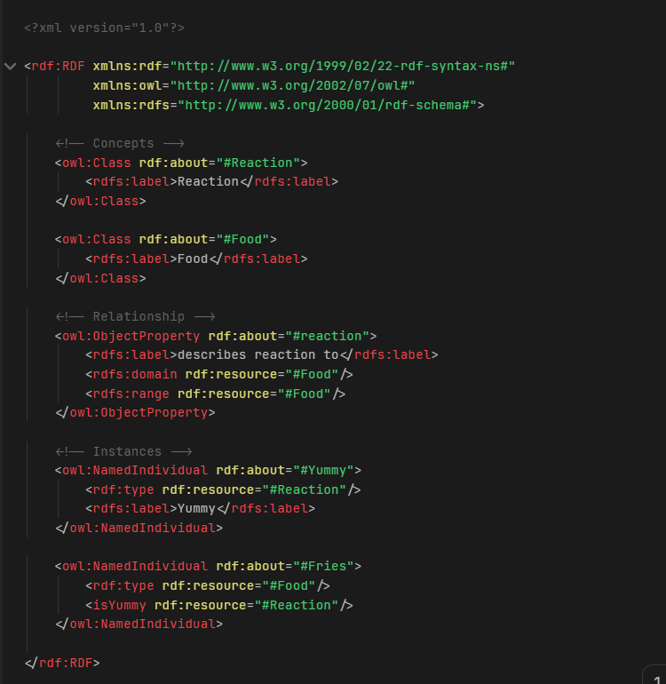
How to implement for machines: RDF
Donuts - are - yummy
One way to capture this is to use RDF
Hard for humans but heaven for machines
Notes:
1. One way to capture this is to use a format know as RDF (Resource Description Framework).
2. The Inherent Complexity of RDF for Human Interpretation:
The (RDF) displayed on the screen may appear as an intricate web of tags and attributes to the human eye. However, for machines, this structure provides a clear, well-defined blueprint of data. It meticulously outlines the nature of each data piece and its relationship with others. In this instance, it's articulating the concept "Donuts are yummy" in a language that a machine can comprehend and process.

Slide 8
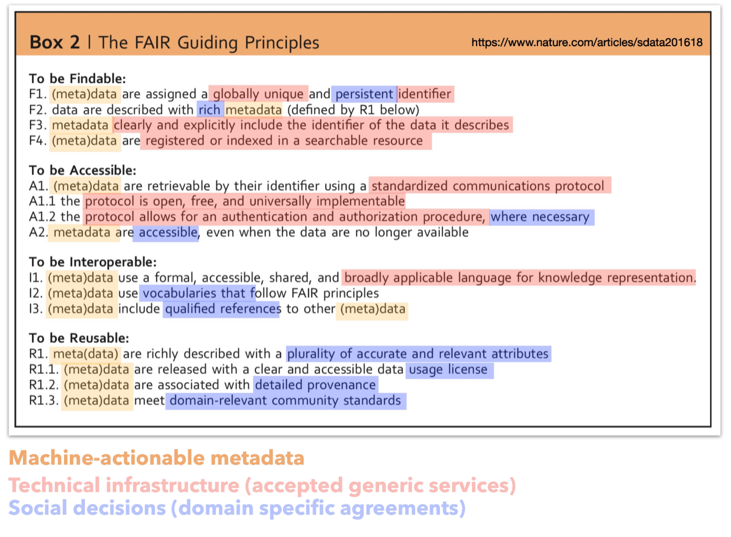
FAIR Implementation: A Collaborative Effort
Domain Specialists:
Involved in governance and conceptual aspects of FAIR implementation.
Tasks include defining the concepts, determining the relationships, and shaping the ontology.
Engineers:
Responsible for the technological aspects of FAIR implementation.
Tasks include capturing the ontology, sharing it, and utilizing it effectively.
Notes:
the implementation of FAIR principles is a collaborative effort that requires both technological expertise and deep domain knowledge.
1. Domain Specialists:
On the other hand, domain specialists are deeply involved in the governance and conceptual aspects of FAIR implementation. They are the ones who define the concepts, determine the relationships, and shape the ontology. Their deep understanding of the subject matter ensures that the ontology accurately represents the data and its relationships.
2. Engineers:
Engineers play a pivotal role in the technological aspects of FAIR implementation. They are tasked with capturing the ontology in a machine-readable format, ensuring it is shared effectively, and utilized in a way that maximizes its potential. Their expertise is crucial in translating the complex concepts and relationships into a format that machines can understand and work with.
By working together, engineers and domain specialists can ensure that data is managed in a way that is Findable, Accessible, Interoperable, and Reusable. The next few slides we will get a high level understand of RDF in preparation for creating our own ontology.

Slide 9
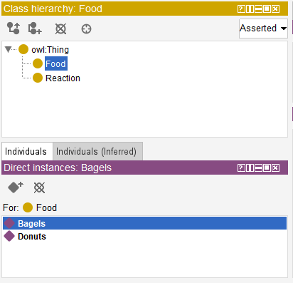
Controlled Vocabulary
Classes:
Represent concepts in a controlled vocabulary.
Food, Reaction
Individuals:
Represent instances of these concepts.
Bagels, Donuts are individuals of food
Notes:
Classes:
In the RDF document, you'll notice elements labeled as 'owl:Class'. These are known as OWL Classes and they represent the concepts in our controlled vocabulary. In our example, 'Food' and 'Reaction' are classes. They are the broad categories or concepts that we want to describe in our data.
OWL Named Individuals:
We also have elements labeled as 'owl:NamedIndividual'. These are known as OWL Named Individuals and they represent specific instances of these concepts. In our example, 'Fries' is an instance of the 'Food' class and 'Yummy' is an instance of the 'Reaction' class. They are the specific data points that fall under our broader concepts.
In essence, OWL Classes and Named Individuals allow us to represent our controlled vocabulary in a structured, machine-readable format. This is a key step in making our data FAIR - Findable, Accessible, Interoperable, and Reusable.

Slide 10
Capturing relationships:
Schools - admit - students
Mosquito - transmit - malaria
Subject - predicate(property) - object
Notes:
Subject-Predicate-Object Triples:
A fundamental concept in RDF is the representation of data as triples, consisting of a subject, a predicate, and an object. This structure allows us to capture relationships between different entities in a clear and structured manner.
The Role of Properties:
In this context, the predicate is often referred to as a 'property'. A property describes the nature of the relationship between the subject and the object. It functions as a bridge, connecting two entities and providing meaningful context about their interaction.
Examples:
Consider the statement "Schools admit students." Here, "Schools" is the subject, "admit" is the property, and "students" is the object. The property 'admit' provides context about the relationship between schools and students.
Similarly, in "Mosquitoes transmit malaria," "Mosquitoes" is the subject, "transmit" is the property, and "malaria" is the object. The property 'transmit' provides context about the relationship between mosquitoes and malaria.
In summary, the concept of subject-property-object triples allows us to capture complex relationships in a structured, machine-readable format. The use of properties is particularly crucial as it provides the necessary context that defines the relationship between entities. This is a key aspect of making our data FAIR.

Slide 11
How to implement for machines: RDF
Donuts - are - yummy
One way to capture this is to use RDF
Hard for humans but heaven for machines
Notes:
1. One way to capture this is to use a format know as RDF (Resource Description Framework).
2. The Inherent Complexity of RDF for Human Interpretation:
The (RDF) displayed on the screen may appear as an intricate web of tags and attributes to the human eye. However, for machines, this structure provides a clear, well-defined blueprint of data. It meticulously outlines the nature of each data piece and its relationship with others. In this instance, it's articulating the concept "Donuts are yummy" in a language that a machine can comprehend and process.
This session will focus on the more domain specialist contributions of crafting ontology more than the tech side of implementing ontologies.

Slide 12
Practical goals
Goal is to expose domain-experts to the tools to start learning, building and sharing ontologies
Bioportal (Repository for Ontologies)
Protégé (Software for working with ontologies)
Activities
Introduce Bioportal and two examples of ontologies:
Data Science Education Ontology
COVID-19 Ontology
Introduce Protégé
Download work with with Bio-portal ontology
Start from scratch (15 minute practical) with a fun subject (Netflix)
Deploy Ontology to Bioportal
Notes:
Overall goal is to expose domain-experts to the tools to start learning, building and sharing ontologies. These tools include:
Bioportal (Repository for ontologies)
BioPortal is a powerful and widely utilized online platform for accessing and exploring biomedical ontologies and terminologies. Developed in Stanford and funded by both the NIH and NSF; this is the main repository for research currently. Started out as a biomedical ontology and that is its focus. Other domains such as public health don’t really have a robust ontology repository specific to this domain so for now most people just use bioportal
Protégé (Software for working with ontologies)
Protege is a popular open source software tool for working with ontologies, developed by the Stanford Center for Biomedical Informatics Research in collaboration with the Stanford University School of Medicine. The project has received funding and support from various organizations, including the National Institutes of Health (NIH), the National Science Foundation (NSF), and the European Union. It contu

Slide 13
Netflix Movie ontology
Classes:
Represent concepts in a controlled vocabulary.
???
Individuals:
Represent instances of these concepts.
???
Relationships:
Represent instances of these concepts.
???
Notes:
Overall goal is to expose domain-experts to the tools to start learning, building and sharing ontologies. These tools include:
Bioportal (Repository for ontologies)
BioPortal is a powerful and widely utilized online platform for accessing and exploring biomedical ontologies and terminologies. Developed in Stanford and funded by both the NIH and NSF; this is the main repository for research currently. Started out as a biomedical ontology and that is its focus. Other domains such as public health don’t really have a robust ontology repository specific to this domain so for now most people just use bioportal
Protégé (Software for working with ontologies)
Protege is a popular open source software tool for working with ontologies, developed by the Stanford Center for Biomedical Informatics Research in collaboration with the Stanford University School of Medicine. The project has received funding and support from various organizations, including the National Institutes of Health (NIH), the National Science Foundation (NSF), and the European Union. It contu

Slide 14
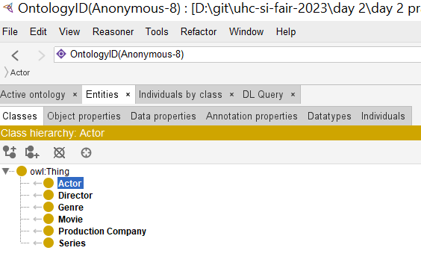
Netflix Movie ontology: Protege
Notes:
Overall goal is to expose domain-experts to the tools to start learning, building and sharing ontologies. These tools include:
Bioportal (Repository for ontologies)
BioPortal is a powerful and widely utilized online platform for accessing and exploring biomedical ontologies and terminologies. Developed in Stanford and funded by both the NIH and NSF; this is the main repository for research currently. Started out as a biomedical ontology and that is its focus. Other domains such as public health don’t really have a robust ontology repository specific to this domain so for now most people just use bioportal
Protégé (Software for working with ontologies)
Protege is a popular open source software tool for working with ontologies, developed by the Stanford Center for Biomedical Informatics Research in collaboration with the Stanford University School of Medicine. The project has received funding and support from various organizations, including the National Institutes of Health (NIH), the National Science Foundation (NSF), and the European Union. It contu

Slide 15
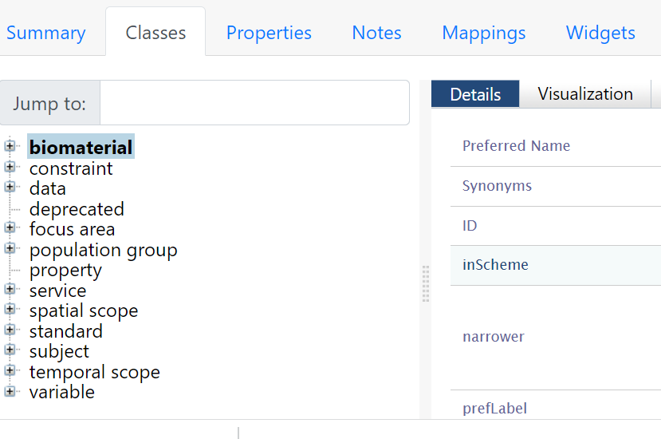
Netflix Movie ontology: Bioportal

Slide 16
Phladelphia Public health ontology
Things to brain storm: please populate this google doc
Classes:
Represent concepts in a controlled vocabulary.
???
Relationships:
Represent instances of these concepts.
???
Individuals:
Represent instances of these concepts.
???
Notes:
Overall goal is to expose domain-experts to the tools to start learning, building and sharing ontologies. These tools include:
Bioportal (Repository for ontologies)
BioPortal is a powerful and widely utilized online platform for accessing and exploring biomedical ontologies and terminologies. Developed in Stanford and funded by both the NIH and NSF; this is the main repository for research currently. Started out as a biomedical ontology and that is its focus. Other domains such as public health don’t really have a robust ontology repository specific to this domain so for now most people just use bioportal
Protégé (Software for working with ontologies)
Protege is a popular open source software tool for working with ontologies, developed by the Stanford Center for Biomedical Informatics Research in collaboration with the Stanford University School of Medicine. The project has received funding and support from various organizations, including the National Institutes of Health (NIH), the National Science Foundation (NSF), and the European Union. It contu

Slide 17
Thanks!

